Slide 1
Incentives in Blockchain system
《Game Theory》Group Presentation
Jiahao Yao, Junhao Dai
2024.6.4

Slide 2
Overview
Blockchain Intro
Incentive Mechanism
Selfish Mining AttaSelfish Mining Attackck
Game Theory For Mining
Game Theory For Security

Slide 3
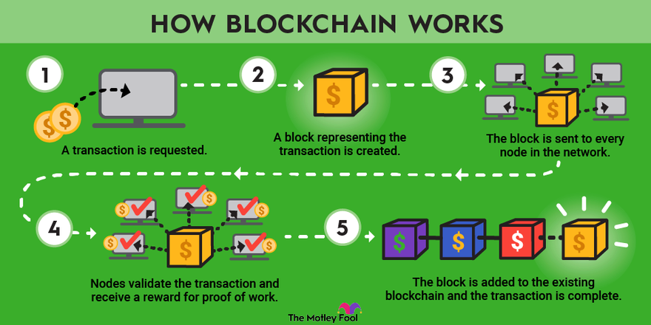
Blockchain Intro
Blockchain is a decentralized, distributed ledger technology that securely records transactions across multiple computers, ensuring data integrity and transparency without the need for a central authority.
Blockchain is a decentralized, distributed ledger technology that securely records transactions across multiple computers, ensuring data integrity and transparency without the need for a central authority.

Slide 4
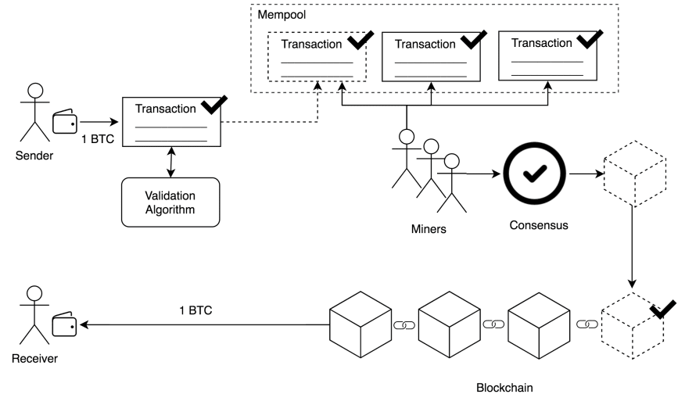

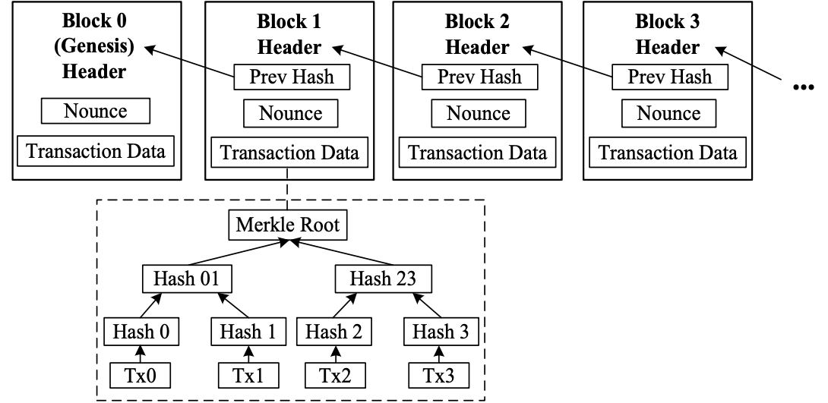
Blockchain Intro
Basic Components：
Transaction
Block
Hash pointer
Merkle Tree

Slide 5
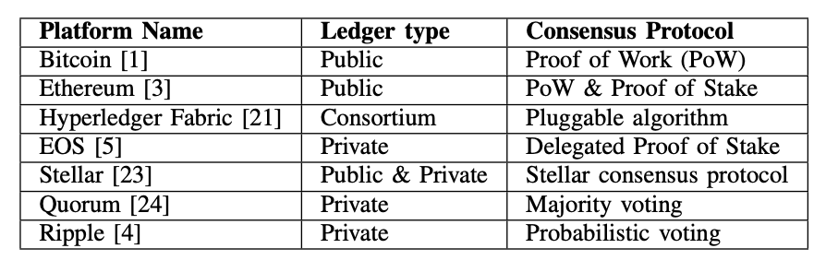
Blockchain Intro
Some Widely-used Blockchain Platforms

Slide 6
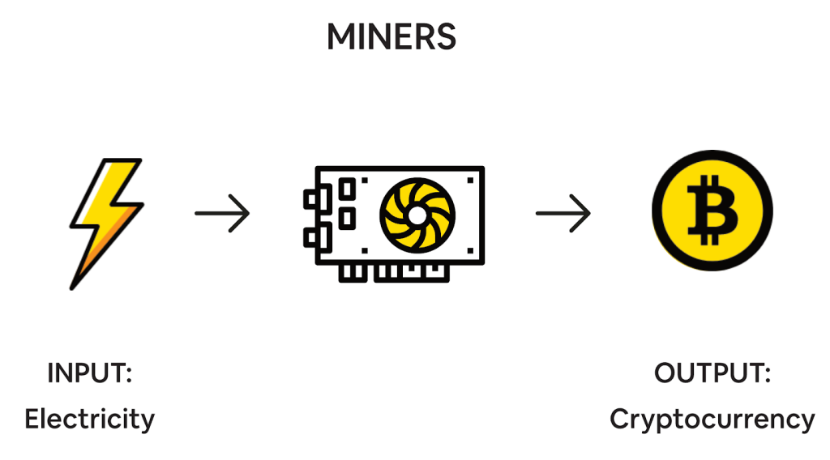
Incentive Mechanism
“ Expending resources to mine gold and inject it into circulation”
Objective
• To ensure all participants are motivated to maintain and secure the network.
• Incentives are crucial for the healthy operation and security of the blockchain.
Objective
To ensure all participants are motivated to maintain and secure the network.
Importance
Essential for the prevention of fraudulent activities and ensuring fidelity and security.
Agreement
Participants are rewarded for contributing computational power.
Types
Mining Rewards: Reward miners for validating transactions and securing the blockchain.
Transaction Fees: Fees paid by users to have their transactions included in the blockchain.

Slide 7
Game Theory For Mining
Three challenges and Game Theory Approach for minig
Objective
• To ensure all participants are motivated to maintain and secure the network.
• Incentives are crucial for the healthy operation and security of the blockchain.
1. Computational Power Allocation
- Challenge: inding the right amount of resources to deploy for maximum efficiency and profit.
- Game Theory Approach: Miners optimize the cost-benefit ratio of resource use to maximize returns.
2. Reward Allocation
- Challenge: Distributing rewards to motivate ongoing participation and honesty.
- Game Theory Approach: Design reward systems that encourage cooperation and align miner incentives with network health.
3. Pool Selection
- Challenge: Selecting a mining pool that maximizes rewards, reliability, and overall returns.
- Game Theory Approach: Miners choose pools based on the best projected earnings and stability.
Solo, PPS, PPLNS...

Slide 8
Division of Work
Objective
• To ensure all participants are motivated to maintain and secure the network.
• Incentives are crucial for the healthy operation and security of the blockchain.
Jiahao Yao:
Game Theory For Mining in blockchain
Junhao Dai:
Game Theory For Security in blockchain

Slide 9
Thanks

